Slide 1
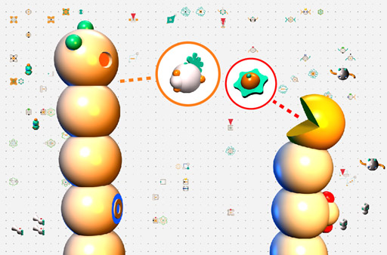
Evolving cooperation in computer simulation
Mikhail Burtsev
Keldysh Institute of Applied Mathematics,
Anokhin Institute of Normal Physiology,
Moscow, Russia
mbur@ya.ru
http://www.keldysh.ru/pages/mrbur-web/

Slide 2
Simulation of evolution
Classical population genetics
Population dynamics
Molecular evolution (hypercycles, etc.)
Evolutionary game theory
Macroevolutionary models (sand pile, NK, etc.)
Artificial life

Slide 3
Problem of cooperation
Why cooperation is evolutionary stable?
Theories:
  Kin selection
  Group selection
  Reciprocity
  Methods
  Classical population genetics
  Population dynamics
  Evolutionary game theory

Slide 4
Why ALife?
  High heterogeneity of behavioral strategies (~10¹⁰⁰⁰ possible strategies)
  Fitness of an agent (strategy) depends on behavior of neighbors
  Implicit testing on evolutionary stability

Slide 5
Main assumptions of the model
Evolution. The strategies in the population evolve through reproduction with variation.
Markers. Individual heritable phenotypic markers provide a potential tool for agents to cooperate.
Local interactions. All agents interact locally, as in real life.
Limited resources. An ability of agent to store resources is limited.

Slide 6
Evolutionary model overview
population of agents
“World”
stimuli
agent
actions

Slide 7
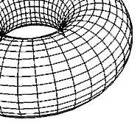
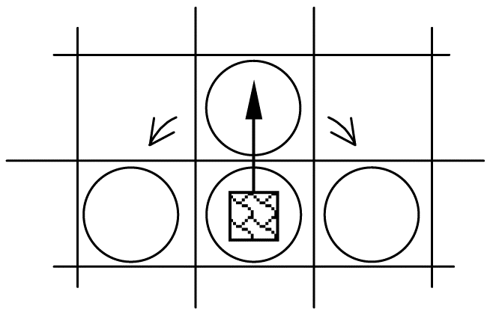
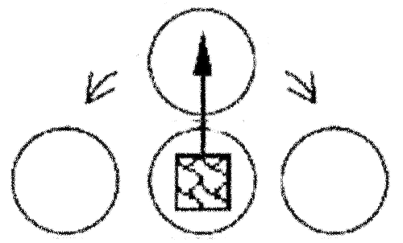
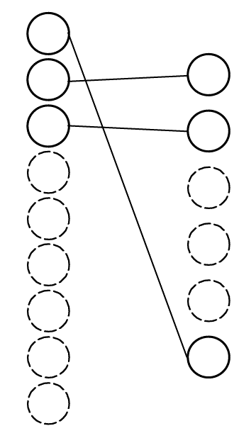
A world
An agent
“brain”
(simulated neural
network)
Phenotypic characters
(marker)
I
1
1
1
0
0
0
0
0
0
W
O
1
1
0
0
0
1
m
m₁
m₂
m₃
...
m_{n}
SENSORY INPUTS
resources in the field of vision
agents in the field of vision
internal resource
kin indication
ACTIONS
rest
turn left/right
move
consume resource
divide
attack

Slide 8
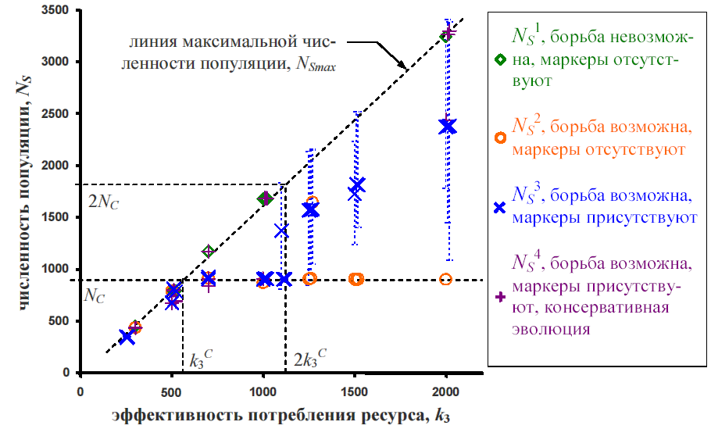
Line of maximal
population density
no fight
no kinship
fight
no kinship
fight
kinship
Number of agents
Resource

Slide 9
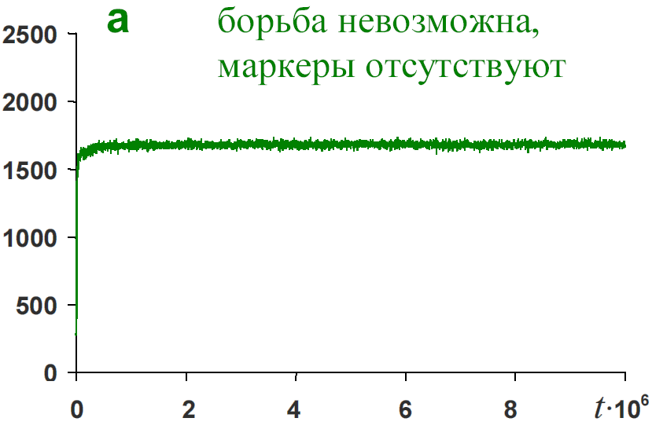
no fight, no kinship
Line of maximal
population density
численность популяции
Number of agents
Number of agents
время, такты
time
Resource

Slide 10
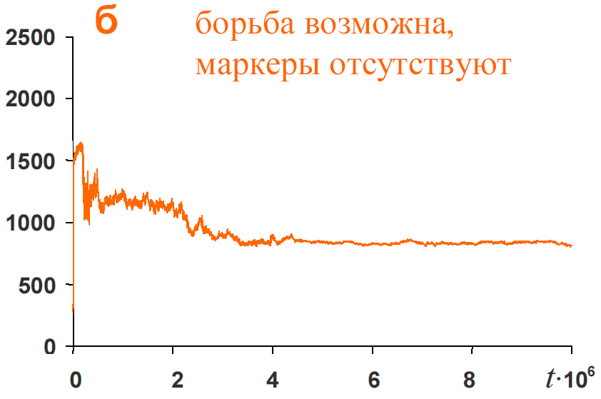
fight, no kinship
Line of maximal
population density
численность популяции
Number of agents
Number of agents
время, такты
time
Resource

Slide 11
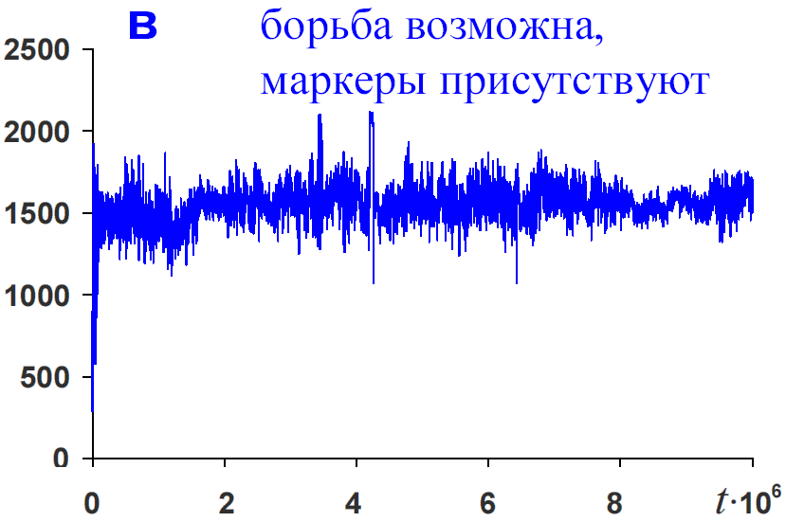
fight, kinship
Line of maximal
population density
численность популяции
Number of agents
Number of agents
время, такты
time
Resource

Slide 12
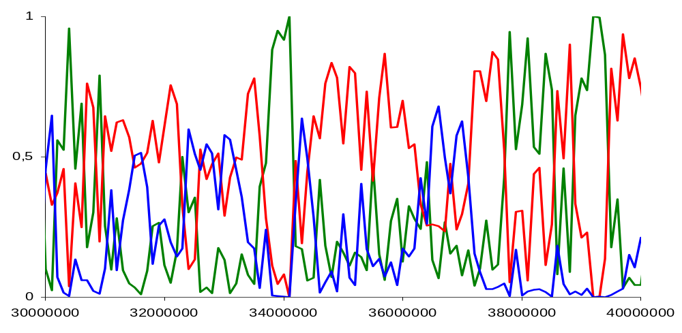
ravens
starlings
doves
time

Slide 13
Main results
Demonstrated that within the ALife framework it is possible to model not only how one strategy displaces another (or not), but the very process by which novel strategies emerge out of a very large space of possibilities
Emergence of cooperative modifications of known strategies – doves and hawks
Discovery of novel strategy – starlings
Importance of cooperation for territoriality studies
Observation of “anti-private property” and “desperado” strategies

Slide 14
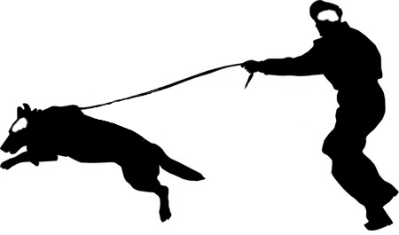

Slide 15
Thank you!

Slide 17
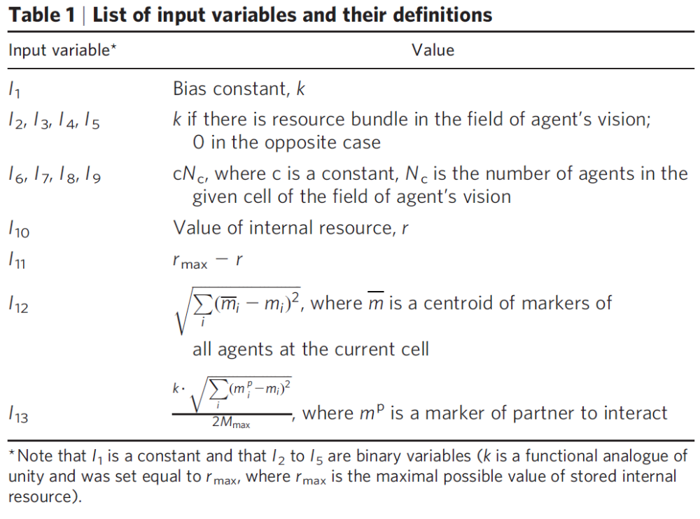

Slide 18
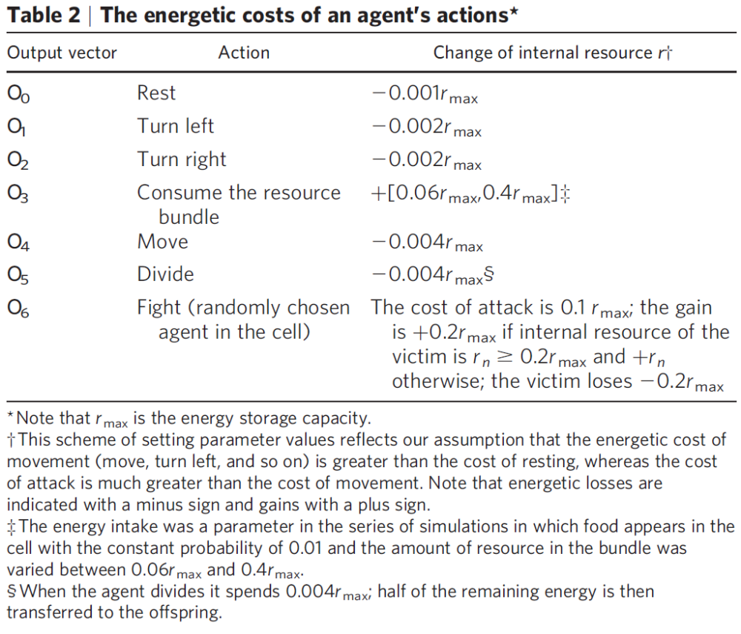

Slide 19
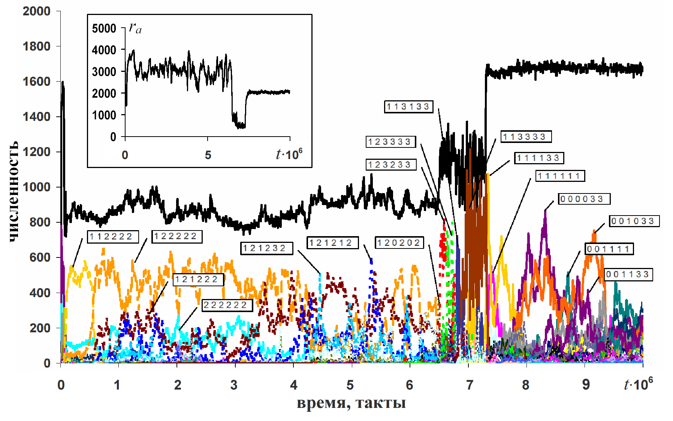
Encoding of strategies and their dynamics
low resource, r = 0,02r_{max} |  | mid resource, r = 0,5r_{max} |  | high resource, r = 0,98r_{max}
kin near | non-kin near | kin near | non-kin near | kin near | non-kin near
a_{i} | a_{i} | a_{i} | a_{i} | a_{i} | a_{i}
Notation: r is level of internal resource; r_{max} is maximal level of internal resource;
a is set of actions {0:"rest or turn"; 1:"move (escape cell)"; 2:"attack"; 3:"divide (reproduce)"}, i = 1,2,3,4.
number of agents
time

Slide 21
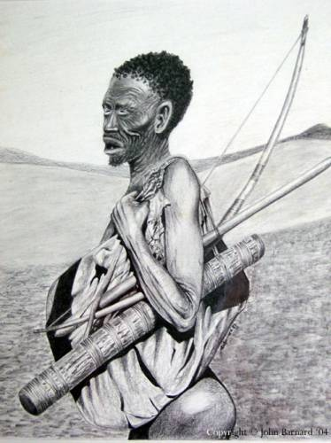
Artificial Life Meets Anthropology

Slide 22
The Problem
What are the determinants of social dynamics in primitive egalitarian societies?

Slide 23
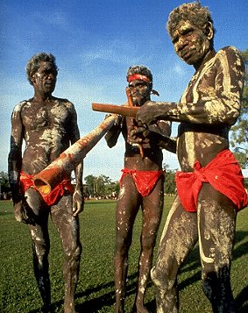
Why aggression?
One of the largest domains in the area of ethnographic, anthropological, and cross-cultural studies of primitive societies is committed to the research on interrelations of resources availability, aggression, and population pressure.
So it can provide us with a variety of theories to compare and with data on the real societies to verify predictions of the simulations.

Slide 24
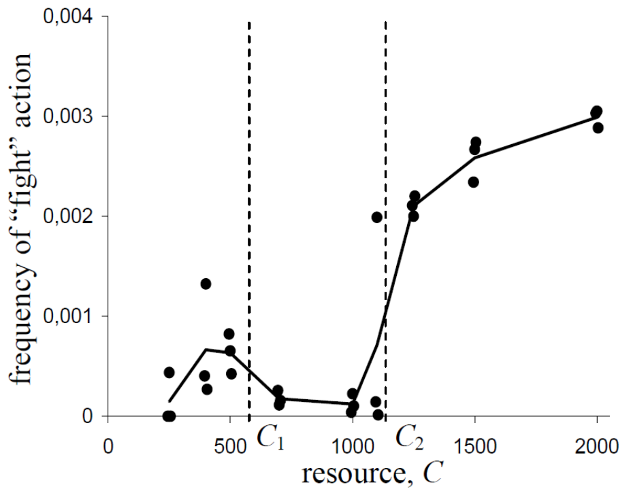
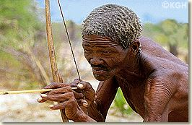
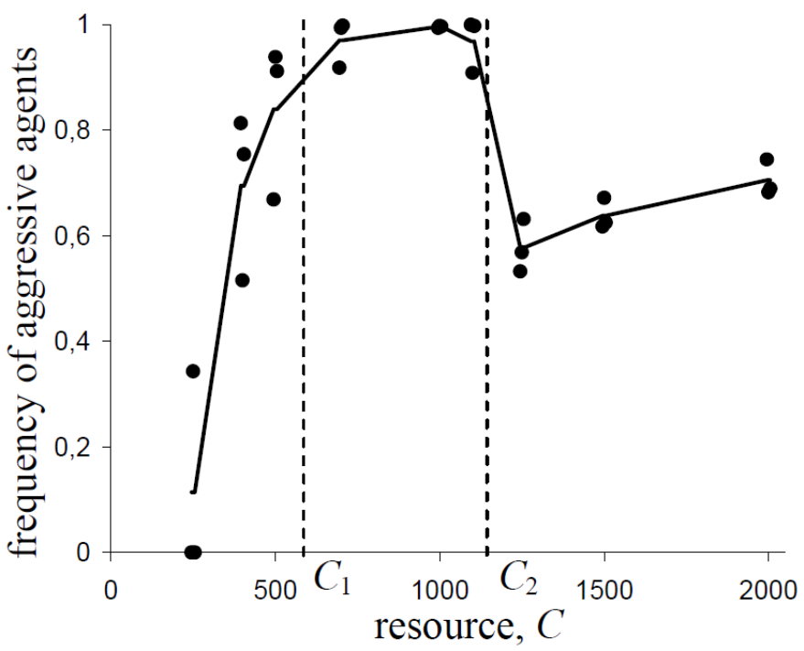
Test 1. Aggression and Resource Supply
ACTUAL AGGRESSION
POTENTIAL AGGRESSION
!Ko
!Kung
PREDICTIONS OF THE MODEL
In the conditions of poor (C < C₁) and rich (C > C₂) resource, a portion of aggressive agents and a frequency of acts of aggression should grow with increase of resource supply.
At intermediate resource supply (C₁ ≤ C < C₂), almost every agent should be able to fight but frequency of actually performed aggressive actions is very low.

Slide 25
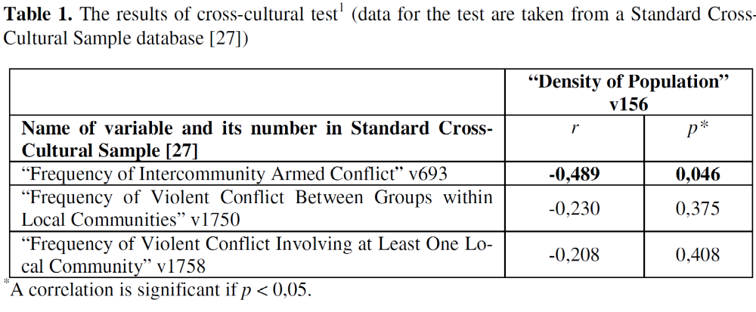
Test 2. Aggression and Density of Population
Prediction of correlation between population density and level of aggression
Malthus positive
Turchin&Korataev (2004) about zero
The model negative ~ -0.5
Cross-cultural data

Slide 26
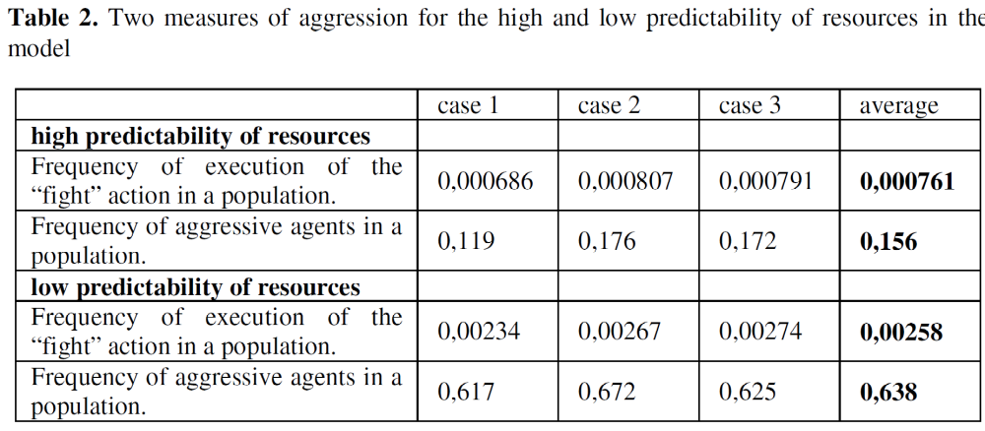
Test 3. Aggression and Predictability of Resources
Cross-cultural data
Natural disasters as predictor of warfare gives correlation
r = 0,631 (p < 0.001)
The model

Slide 27
Conclusions

Slide 28
The model—based on assumptions of heritable markers, constrained resource, and local interactions—demonstrates surprising fit to some features of real archaic egalitarian societies:
The model captures a general trend of increasing of the aggression level with a rising resource supply in primitive societies but grasps also some exceptions such as a case of !Ko and !Kung in Kalahari desert which demonstrates reverse interdependence between resource base and aggression.
The correlation between population density and frequency of fight action for the case of rich resources in the model is similar to the analogous correlation extracted from ethnographic database contrary to the theories which not consider cooperation.
Finally, impact of resource predictability on internal warfare observed for real societies is correctly replicated in the model’s behavior.

Slide 29
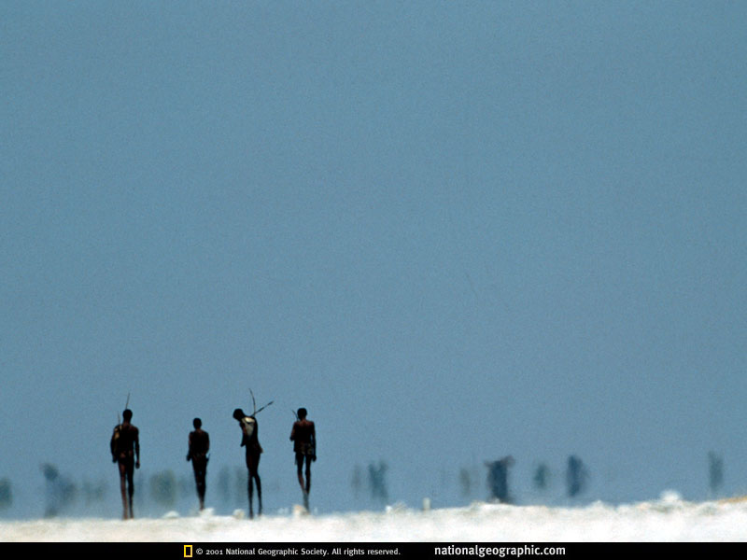

Slide 30
Thank you!

